Slide 1
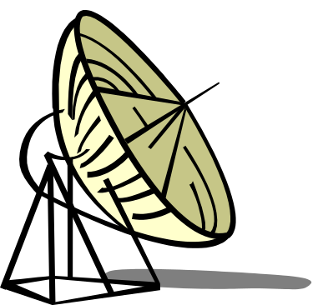
Radar Principles
&
Systems
Notes:
Review: There are 4 components to any weapon system. (Detect, Direct, Deliver, and Destroy)
Therefore, we must understand how to detect targets, but what unique characteristics make targets distinguishable?
Energy emitted or reflected in the form of electrical, audio, heat or visible light
What characteristic do all of these have in common?
- They all propagate in waves – Waves have certain characteristics
- We utilize Maxwell’s Equations (relationship between E and B)
- How waves are Polarized - How waves propagate Interact with surrounding (Reflection, Refraction (Snells Law).
, Diffraction) and travel (Space, Sky, Ground)
- Waves encounter losses (spreading, absorption), so how do we extend range Antenna Height, Power, Modulation
What is RADAR an acronym for? Radio Detection and Ranging.
Radio wave is generated, transmitted, reflected, and detected.(RF Band 1Mhz – 25 Ghz)
RADAR unimpaired by night, fog, clouds, smoke.
Not as detailed as actual sight.
RADAR is good for isolated targets against a relatively featureless background.

Slide 2
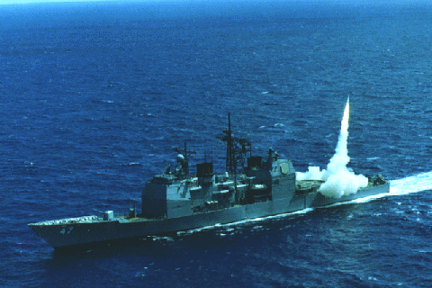
Two Basic Radar Types
Pulse Transmission
Continuous Wave
Notes:
Pulse - RADAR transmits a series of pulses separated by non-transmission intervals during which the radar “listens” for a return.
Continuous Wave - Constantly emitting radar. Relative motion of either the radar or the target is required to indicate target position. Frequency shift.

Slide 3
Pulse Transmission
Pulse Width (PW)
  Length or duration of a given pulse
  Determines minimum range of detection
Pulse Repetition Time (PRT=1/PRF)
  PRT is time from beginning of one pulse to the beginning of the next
  PRF is frequency at which consecutive pulses are transmitted. (Pulses per second)
Notes:
1. The pulse width determines the minimum range that the target can be detected.
a. If transmitter is still on when the pulse (echo)is returned then won’t see
the return.
b. Need short pulses to detect close targets.
Pulse power: Need long pulses to have sufficient power to reach targets that have long ranges.
Pulse Repetition Time and Pulse Repetition Frequency
PRT Definition: The elapsed time between the beginning of one pulse transmission and the next. PRT=1/PRF

Slide 4
Pulse Diagram
PRT
Carrier Freq.
“Listening”
Time
PW
PRT=1/PRF
Notes:
Figure 8-2, pg. 90 in B book.
PW - Minimum range and Maximum Range
Minimum - PW determines when the radar begins listening for a target return
Maximum - PW determines “on time” for average power, need more power to look long distances due to losses
PRF - Maximum Range
Quit listening for a return pulse and transmit again
Duty Cycle = Pw/PRT = Pw*PRF (ratio of time the transmitter is on to one cycle of operation)
PRF = 1/PRT
Key points:
1. Varying the pulse width affects the range of the radar.
2. Need short pulses for short range targets.
3. PW determines radar’s minimum range resolution.
4. The slower the PRF the greater the radar’s maximum range.
5. The faster the PRF the greater the radar’s accuracy.

Slide 5
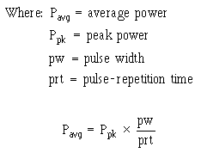
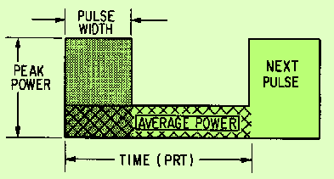
Pulse Diagram II
Notes:
Basically, we’re taking the area of the pulse and spreading it out over time (PRT)
Peak Power: maximum signal power of a pulse; affects maximum range of the radar
Since the radar system is not transmitting for a long period of its total cycle, the average power (total power transmitted per unit time) is quite low compared to the peak power during the pulse time. Relationship shown in equation.
Also, Duty Cycle = Average Power/Peak Power

Slide 6
Pulse Radar Components
Synchronizer
Transmitter
RF Out
Power
Supply
Duplexer
ANT.
Echo In
Display Unit
Receiver
Antenna Control = Bearing and/or Elevation
Notes:
1. Make copies of graphic and distribute to class. (p. 91 in text)
2. Synchronizer: Central Nervous System or Brain
a. Coordinates the entire system
b. Determines the timing of the transmitted pulse
c. Includes timers, modulator and central control.
3. Transmitter:
a. Generates the pulse (RF) at the proper frequency and amplifies.
4. Antenna:
A. Receives energy from the transmitter, radiates it in the form of a
highly directional beam.
B. Receives the echoes for pulse radars.
5. Duplexer: (What is the difference between full and half (walkie talkie) Duplex)
a. Allows one antenna to be used to transmit and receive.
b. Prevents transmitted RF energy from going directly to the receiver.
c. Tells the antenna to radiate or receive.
6. Receiver: receives incoming echoes from antenna, detects and amplifies
the signal, and sends them to the display.
7. Display: Displays the received video to the operator.
8. Power Supply: Provides power to all the components of the system.

Slide 7
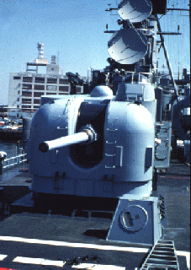

Continuous Wave Radar
Employs continual RADAR transmission
Separate transmit and receive antennas
Relies on the “DOPPLER SHIFT”
Notes:
Second major type of radar.
Produces a constant stream of energy.
Can’t distinguish distances (range) because no interval between pulses.
Distinguishes between moving and non-moving targets by using Doppler frequency shifts.
“Doppler Shift”
Light from moving objects will appear to have different wavelengths depending on the relative motion of the source and the observer
Austrian physicist Christian Johann Doppler noted that the wavelength of light, sound, or any other kind of propagating energy measured by a moving observer will be shifted by a factor of:
(v/c)
where v is the velocity at which the observer is approaching or receding from the source (relative velocity) and c is the speed at which the wave propagates.
C – Speed of sound is 350 m/s
V - 33 1/3 m/s

Slide 8
Doppler Frequency Shifts
Motion Away:
Echo Frequency Decreases
Motion Towards:
Echo Frequency Increases
Notes:
(p. 104 in text)
1. Doppler frequency shift describes the effect that motion has on a reflected
frequency.
2. Use the diagram to show: “Think of Tennis Balls”
a. If the wall is moving away a ball will have to travel farther than the
previous ball so the reflected balls are further apart.
b. If the wall is moving toward, a ball will have to travel a shorter distance
than the previous ball so the reflected balls are closer together.
3. If you assume that each ball represents the top of a wave so the distance
between each ball represents a wave cycle then you find:
a. The frequency of the echo is lower if the target is moving away.
b. The frequency of the echo is higher if the target is coming towards.
** This is why the sound of a passing train or airplane goes from
higher pitch to lower pitch.
4. Key Points:
a. Frequency expansion is the lowering of the echo frequency caused
by an opening target (target moving away). DOWN DOPPLER
b. Frequency compression is the raising of the echo frequency caused
by the closing target (target moving closer). UP DOPPLER
c. The moving of the transmitter can also cause frequency shifts (it’s
relative motion that produces the effect).
d. The faster the relative motion change the greater the frequency shift.

Slide 9
Continuous Wave Radar Components
Transmitter
Antenna
CW RF
Oscillator
OUT
Discriminator
AMP
Mixer
IN
Antenna
Indicator
Notes:
Make copies for distribution.
1. Transmit/Receive Antennas. Since the antenna must operate simultaneously, must be located separately so receiving antenna doesn’t pick up transmitted signal.
2. Oscillator or Power Amplifier. Sends out signal to transmit antenna. Also sends sample signal to Mixer. (used as a reference)
3. Mixer.
a. A weak sample of the transmitted RF energy is combined with the received echo signal.
b. The two signal will differ because of the Doppler shift.
c. The output of the mixer is a function of the difference in frequencies.
4. Amplifier. Increases strength of signal before sending it to the indicator.
5. Discriminator. Filter
a. Selects desired frequency bands for Doppler shifts, eliminates
impossible signals (Land mass, non-moving targets, etc.)
b. The unit will only allow certain frequency bands so won’t process stray
signals.
6. Indicator. Displays data. Displays velocity or the component directly inbound or directly outbound. Range is not measured. (no basis for the measurement of the time delay).
Filters. Used to reduce noise, used in amp to reduce sea return, land clutter, and other non-desirable targets.

Slide 10
Pulse Vs. Continuous Wave
Pulse Echo
Single Antenna
Gives Range, usually Altitude as well
Physical Range Determined By PW and PRF.
Susceptible To Jamming
Continuous Wave
Requires 2 Antennae
Gives RATE OF CHANGE of target range
High SNR
More Difficult to Jam But Easily Deceived
Amp can be tuned to look for expected frequencies
Notes:
Discuss Slide
Range for CW can be determined w/ more complicated Frequency Modulated Continuous Wave. (p.106)
Altitude for CW: Slant range (see coming slide)
Range Resolution – Ability to separate two targets at nearly the same range – Better resolution requires narrow PW (SAME AS MIN RANGE)
R = ct/2 “Think => D = v*t”
C is speed of wave propagation
T time required for round trip
3x10⁸ m/s
186,000 miles/sec
300 m/usec

Slide 11
RADAR Wave Modulation
Amplitude Modulation
  Vary the amplitude of the carrier sine wave
Frequency Modulation
  Vary the frequency of the carrier sine wave
Pulse-Amplitude Modulation
  Vary the amplitude of the pulses
Pulse-Frequency Modulation
  Vary the Frequency at which the pulses occur
Notes:
Draw waves on the board and discuss. Pg 41 of Tan Textbook
1. The basic radar and communication transmission waves are modified to:
a. Allow the system to get more information out of a single transmission.
b. Enhance the signal processing in the receiver.
c. To deal with countermeasures (jamming, etc.)
d. Security (change characteristics)
2. Both CW and Pulse signals can be changed or MODULATED
3. Show slide.
4. Common Modifications are:
a. AM
b. FM
c. Pulse Amplitude
d. Pulse Frequency
5. Modulation is achieved by adding signals together.

Slide 12
Antennae
Two Basic Purposes:
  Radiates Energy
  Provides Beam Forming and Focus
Must Be 1/2 of the Wave Length for the maximum wave length employed
Wide Beam pattern for Search, Narrow for Track
Notes:
The antenna is used to radiate the energy created by the transmitter. It also receives the reflected energy and sends it to the receiver. Remember from discussion on how a transmission is made.
a. A dipole antenna is the simplest form of RF antenna.
b. Optimal radiation is achieved with an antenna length of 1/2
a wave length long or multiples thereof.
c. Electrical field strength is strongest in middle and least at top/bottom.
d. Maximum field strength is perpendicular to the antenna
e. Field extends 360 degrees around antenna.
2. Beam Pattern represents the electromagnetic field around antenna.
a. It is a snap shot at any given time.
b. Lines represents field strength (in the example it is strongest on x axis)
c. Field goes to near zero 30-40 degrees off horizontal axis
3. Simple antenna doesn’t help us locate a target just that he is in the cone.
It would be a help if we could:
a. Illuminate a specific area (for accurate location data)
b. Not wasting power by looking in unwanted directions
c. Focus more power in the area we want to look at
4. We improve system performance and efficiency through manipulation of the beam’s formation. The major way we do this is by the antenna.
x
y
Z
Direction of E

Slide 13
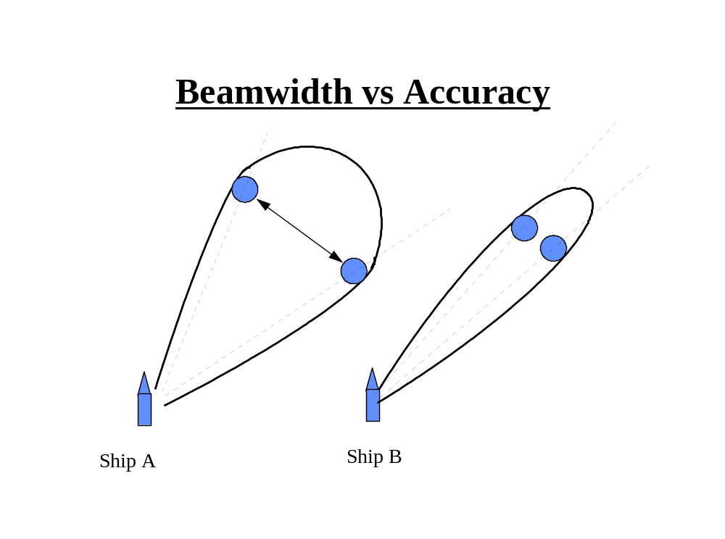
Beamwidth Vs. Accuracy
Notes:
The size of the width of the beam (beam-width) determines the angular accuracy of the radar. From drawing we see that the target could be any where in the beam to produce a return. Ship B can more accurately determine where the target really is.
Beam width is determined where power has dropped to ½ Max
2. The function of the radar determines how narrow the beam-width is needed.
a Search radars sacrifice accuracy for range. (wide beam-widths at high
power)
b. Tracking or targeting radars require more accuracy (narrow beam-
widths)
3. If the target is located on the center line of the beam lobe, the return will be the strongest.
Key Point:. Beam-widths determine the angular accuracy of the radar.
Lead in: Angular accuracy can be use to measure azimuth and elevation depending on which way the antenna is oriented.

Slide 14
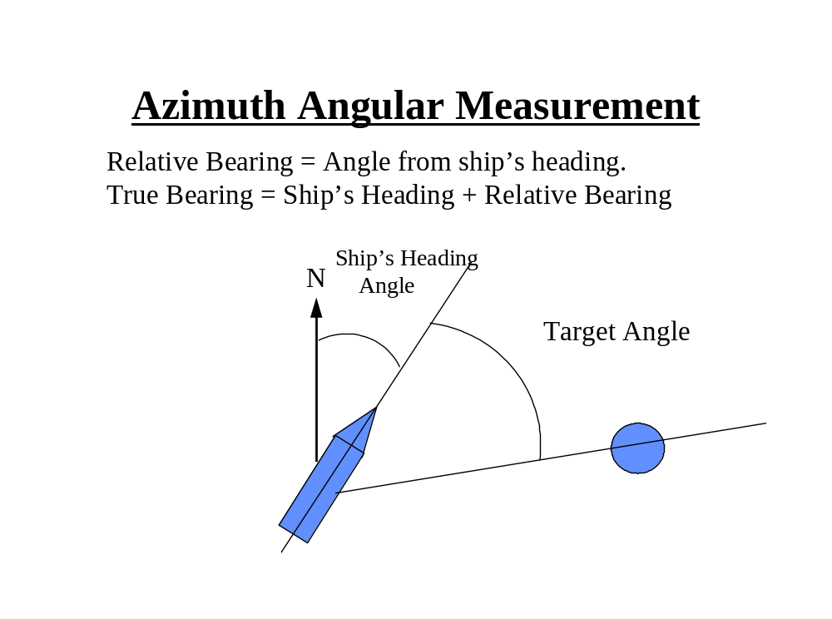
Azimuth Angular Measurement
Notes:
1. We get range from measuring the time the pulse takes to get from the antenna until the echo is received back. Pulse Radar
2. We can get angular range by measuring the antenna angle from the heading of the ship when it is pointing at the target.
For true direction this angle is added to the heading of the Relative heading is just this angle from the ship.
(If the summation is >360 degrees subtract 360 degrees).

Slide 15
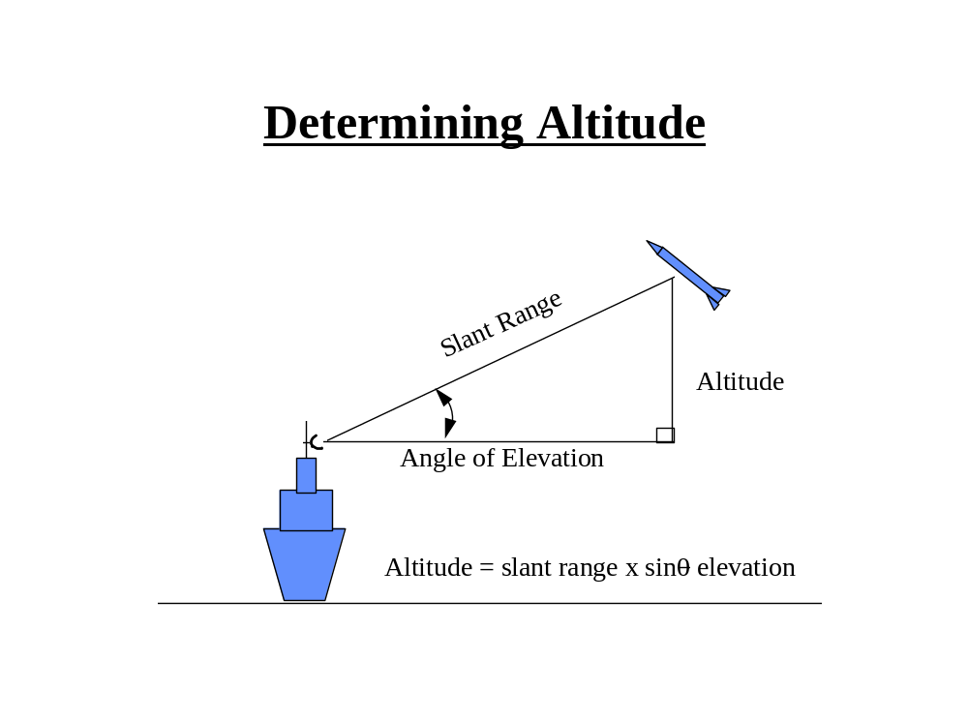
Determining Altitude
Notes:
1. Show slide to show that angular measurements is simple geometry to determine height.
Note:
a. Must adjust for the height of the radar antenna.
b. If the target is low and point the beam low you could get returns from
the water surface.
- Sea Return or “Sea Clutter”

Slide 16
Concentrating Radar Energy Through Beam Formation
Linear Arrays
  Uses the Principle of wave summation (constructive interference) in a specific direction and wave cancellation (destructive interference) in other directions.
  Made up of two or more simple half-wave antennas.
Quasi-optical
  Uses reflectors and “lenses” to shape the beam.
Notes:
1.. We have seen the advantages of having a strong, narrow beam.
How do we produce the beam?
-Linear Arrays(T p.45):
a. Work because can add waves together to get constructive or destructive
interference.
b. Common types of Linear arrays include: Broadside and Endfire Arrays.
c. SPY is a phased array radar, more than 4,000 beams for constructive/destructive interference
-Lenses:
a. Are like optical lenses they focus the beam through refraction of the energy wave.
b. Can only effectively be used with very high frequencies such as microwaves.

Slide 17
Wave Guides
Used as a medium for high energy shielding.
Uses A Magnetic Field to keep the energy centered in the wave guide.
Filled with an inert gas to prevent arcing due to high voltages within the waveguide.
Notes:
Provide efficient means of conducting energy from transmitter to the antenna.
A cable would act as a short circuit if used at the high frequencies of waves we use.
Hollow dialectic gas filled tube of specific dimensions.
Doesn’t work like a wire conducting current. A totally different concept.
Open end is properly flared, an electromagnetic horn is created which transmits the energy
Should know what a wave guide is for and that if dented, crushed or punctured, it can adversely effect the performance of the system.
Don’t bang on wave guides!!
Page 52 Tan Text

Slide 18

Questions?

Slide 19
Radar Principles and Systems
Part II

Slide 20
Factors That Affect Radar Performance
Signal Reception
Receiver Bandwidth
Pulse Shape
Power Relation
Beam Width
Pulse Repetition Frequency
Antenna Gain
Radar Cross Section of Target
Signal-to-noise ratio
Receiver Sensitivity
Pulse Compression
Scan Rate
  Mechanical
  Electronic
Carrier Frequency
Antenna aperture
Notes:
Go through this slide.
See following slides for definitions of the various factors.

Slide 21
Radar Receiver Performance Factors
Signal Reception
Signal-to-Noise Ratio
Receiver Bandwidth
Receiver Sensitivity
Notes:
These are all factors of the design of the radar receiver.

Slide 22
Signal Reception
•
Only a minute portion of the
RF is reflected off the target.
•
Only a fraction of that returns
to the antenna.
•
The
weaker
the signal
that
the receiver can process, the
greater the effective range
.

Slide 23
Signal-to-Noise Ratio
Measured in dB!!
Ability to recognize target in random noise.
  Noise is always present.
  At some range, noise is greater than target’s return.
Noise sets the absolute lower limit of the unit’s sensitivity.
Threshold level used to remove excess noise.
Notes:
Signal-to-Noise Ratio:
a. Noise (always present) sets the absolute lower limit of the sensitivity of
the radar sets. (At some range the noise will be greater than the echo)
Example: Look at a cb radio. If you turn down the volume eventual you will not hear the music only the static. The static is noise.
b. Noise includes atmospheric disturbances, Jamming, stray signals.
Noise is inherent in electronic circuits as random electron
motion through a resister causes stray noise.
c. To cope with this problem, the operator can set a threshold level. If
signals are below this threshold level, they will not be displayed.
* If threshold level is set too low - you get many false detentions.
* If set to high - could mask out the real contact. Must compromise.
Target Returns
False Alarms
Threshold Level
Mean Noise Level

Slide 24
Receiver Bandwidth
Is the frequency range the receiver can process.
Receiver must process many frequencies
  Pulse are generated by summation of sine waves of various frequencies.
  Frequency shifts occur from Doppler Effects.
Reducing the bandwidth
  Increases the signal-to-noise ratio(good)
  Distorts the transmitted pulse(bad)
Notes:
Receiver Bandwidth:
a. To create a pulse many different frequency sine waves are summed so a
radar must combine RF energy of different frequencies. Typically a receiver should handle 1 to 5 Mhz
b. Doppler effects also shift the frequencies so the radar must be capable of
receiving and processing many frequencies.
c. The range of frequencies is the bandwidth of the receiver.
d. Reducing the bandwidth increases the signal-to-noise & distorts the pulse because the leading and trailing edges would be less perfect. This will be covered again in Pulse Shape effects coming up.
Larger Bandwidth will increase the noise returned.

Slide 25
Receiver Sensitivity
Smallest return signal that is discernible against background noise.
  Milliwatts range.
An important factor in determining the unit’s maximum range.
Notes:
Receiver Sensitivity:
a. Defined as the smallest return signal that can produce an electrical signal
to the indicator that is discernible against the noise background.
b. Sensitivity is an important factor in determining the maximum radar
range.
c. Smallest discernible signal is measured in milliwatts and is referred to
the Minimum Detectable Signal.

Slide 26
Pulse Effects on Radar Performance
Pulse Shape
Pulse Width
Pulse Compression
Pulse Power

Slide 27
Pulse Shape
Determines range accuracy, minimum/ maximum range, resolution/definition of the target
Ideally we want a pulse with vertical leading and trailing edges.
  Very clear signal – easily discerned when listening for the echo.
Notes:
Pulse Shape (T p.62 Figure 2-35)
a. A pulse is made by summing several sinusoid waves of various
frequencies.
- A perfect pulse (vertical leading and trailing edges) requires
the receiver to process an infinite number of sine wave freq.
Large Bandwidth => Increases noise returned therefore SNR goes down (bad).
- Internal circuit noise will also distort a pulse.
b. Determines the range accuracy. (closer to vertical the better)
c. Pulse shape can also effect minimum detection range.
- Already discussed that. Pulse must be off before echo returns
.∆t
R = ct/2
w/ Noise

Slide 28
Pulse Width
Determines the range resolution.
Determines the minimum detection range.
Can also determine the maximum range of radar.
The narrower the pulse, the better the range resolution.
Notes:
. Pulse Width.
a. Determines range resolution and minimum detection range for same
reasons as pulse shape. Can’t have pulse on when the echo returns.
b. To lesser extent, pulse width can determine maximum range.
- Pulse has to be big enough to hold enough energy to travel to the
target and return.
- The bigger the pulse the more energy it can hold and the further
away the target can be an still get a measurable return.
- [Power in wave is product of peak power and pulse width]
c. The narrower the pulse the better the range resolution
- This is a trade off with amount of power in the pulse and the effective maximum range of the radar. LIMITS the range.

Slide 29
Pulse Compression
Increases frequency of the wave within the pulse.
Allows for good range resolution while packing enough power to provide a large maximum range.
Notes:
Pulse Compression. Technique that allows use of wide pulses to enhance detection capability while maintaining the range resolution like short pulsed transmissions. See page 63 Tan Text
a. Technique of modifying the pulse so that the frequency in the pulse continually is increased.
b. This allow more energy to be put in a pulse increasing range.
How it works:
a. When pulse echo returns it passes through filters which slow down passing lower frequencies so faster end frequencies
pile up on top of lower frequencies
b. This results in a higher return pulse output and a narrower pulse width.
Pulse is compressed
A
B
A
B
B
A

Slide 30
Pulse Power
The “Ummph” to get the signal out a long way.
High peak power is desirable to achieve maximum ranges.
Low power means smaller and more compact radar units and less power required to operate.

Slide 31
Other Factors Affecting Performance
Scan Rate and Beam Width
  Narrow beam require slower antenna rotation rate.
Pulse Repetition Frequency
  Determines radars maximum range(tactical factor).
Carrier Frequency
  Determines antenna size, beam directivity and target size.
Radar Cross Section (What the radar can see(reflect))
  Function of target size, shape, material, angle and carrier frequency.
Notes:
1. Scan Rate and Beam Width
a. If have wide beam can scan area more rapidly
b. If small have to go slower, give target more time to get close without
being detected.
Pulse Repetition Frequency
a. Already talked about. Can’t have next pulse transmitting when the
echo from the previous one is still on the way back.
3. Carrier Frequency
a. Determines antenna size and directivity of beam.
b. Lower Frequency the longer the distance can travel, the bigger the
antenna required, and the more power required.
c. The higher the frequency the better the resolution and the ability to
detect smaller targets. Also the small the antenna size and the greater
the attenuation losses.
4. Radar cross section
a. Function of the target. Reflectivity of the target.
b Desire good flat surfaces (perpendicular to wave) so reflect signal good,
made of material that doesn’t absorb RF, and is as big as a house.
This is where Stealth comes to play. Lower the object’s radar cross section.

Slide 32
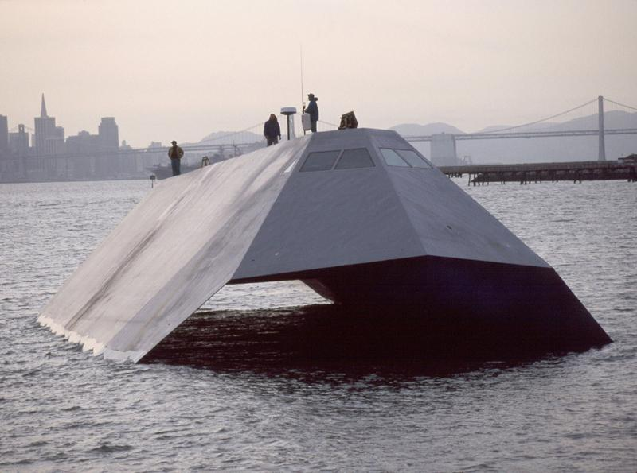
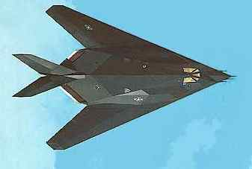
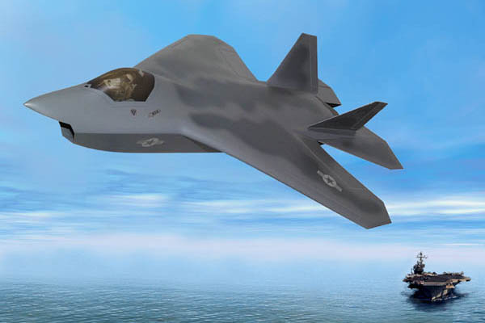
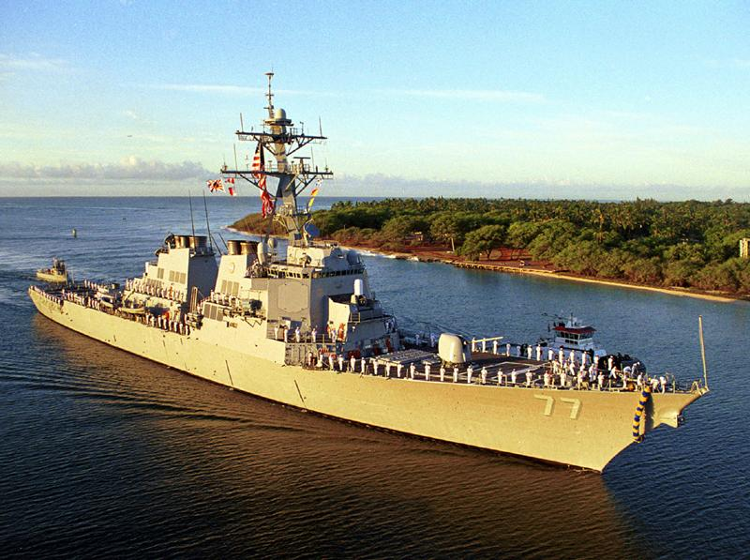
Notes:
Low RCS!

Slide 33
Summary of Factors and Compromises
Summary of Factors and Compromises
Factor
Desired
Why
Trade-off Required
Pulse Shape
Sharp a rise as possible
Better range accuracy
Require infinite bandwidth, more complex
Tall as possible
More power /longer range
Requires larger equipment/more power
Pulse Width
Short as possible
Closer minimum range
Reduces maximum range
More accurate range
Pulse Repetition Freq.
Short
Better range accuracy
Reduces maximum range
Better angular resolution
Better detection probability
Pulse Compression
Uses technique
Greater range
More complex circuitry
Shorter minimum range
Power
More
Greater maximum range
Requires larger equipment & power
Beam Width
Narrow
Greater angular accuracy
Slow antenna rate, Detection time
Carrier Frequency
High
Greater target resolution
Reduces maximum range
Detects smaller targets
Smaller equipment
Receiver Sensitivity
High
Maximizes detection range
More complex equipment
Receiver Bandwidth
Narrow
Better signal-to-noise ratio
Distorts pulse shape

Slide 34
Specific Types of Radar
Frequency Modulated CW Radar
  Use for radar altimeters and missile guidance.
Pulse Doppler
  Carrier wave frequency within pulse is compared with a reference signal to detect moving targets.
Moving Target Indicator (MTI) System
  Signals compared with previous return to enhance moving targets. (search radars)
Frequency Agile Systems
  Difficult to jam.
Notes:
1. Frequency Modulated CW Radar (p. 106)
- Good for radar altimeters and missile guidance
2. Pulse Doppler (p. 114)
- Can use advantages of CW and Pulse radars
- Can color-code the return. Commonly used for weather radars. In military applications, the colors can represent a target moving away from you vice towards.
- The doppler shift on the return translates to a color shift in the visible spectrum.
3. MTI (p. 112)
- Can be used for enhancing targets that are moving
- Example: In a chaff environment, the stationary chaff can be deleted
and the returns of the moving target identified.
4. Frequency Agile
- Harder to jam. “Frequency Jumping”

Slide 35
Specific Types of Radar
SAR / ISAR
Phased Array - Aegis
  Essentially 360° Coverage
  Phase shift and frequency shift allow the planar array to “steer” the beam.
  Also allows for high / low power output depending on requirements.
Notes:
SAR / ISAR (p. 118-120) Blue Text
Synthetic Aperture Radar
Satellites
Inverse Synthetic Aperture Radar
-Long range imaging and identification of possible targets
Phased Array (p. 121) - Aegis system

Slide 36
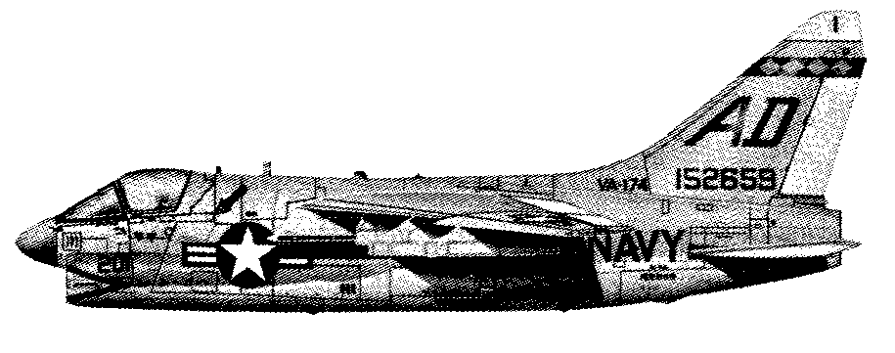
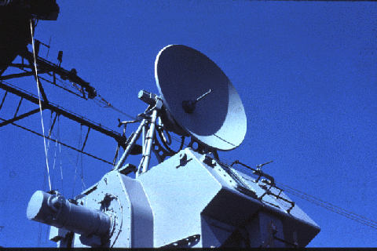
Questions?
Transmission
Wasted Echo
Echo

Slide 37
Notes:
Stealth Ship
Designed to test the effects of stealth technology on Naval Warships.
What kind of radar reflection will we get off this target?
Note the angles, also coated with radar absorbing material.
Lockheed Sea Shadow
Advanced Research Projects Agency (ARPA), the Navy, and Lockheed Martin Missiles and Space Company. The Sea Shadow program was begun in the mid-1980s. Its purpose is to explore a variety of new technologies for surface ships, including ship control, structures, automation for reduced manning, seakeeping and signature control

